Slide 1

GROUP 16 SAI ANMISHA DODDAMREDDY ANUSHA PERLA SAI SHIVANI CHIRAG MANUSHA GADDE
Predictive analysis of health care devices based on physical activity

Slide 2
Introduction
The evolution of technology has made it possible for users to collect multifaced information about their lifestyles and fitness routine. Wearable fitness and health monitoring gadgets have grown in popularity and have become one of the fastest-growing segments of the smart device market. Fitness applications for smartphones have grown highly popular among fitness fanatics and the general public. The evolution of technology has made it possible for users to collect multifaced information about their lifestyles and fitness routine. Wearable fitness and health monitoring gadgets have grown in popularity and have become one of the fastest-growing segments of the smart device market. Fitness applications for smartphones have grown highly popular among fitness fanatics and the general public.

Slide 3
OBJECTIVE
Our goal of this project is to identify any trends in smart device usage and to understand how these trends apply to Bellabeat customers and influence Bellabeat marketing strategy.
ASSUMPTIONS
"Distance" will be interpreted as the meter length detected by the device's GPS system, not as human input
"Time" shall be taken to refer to the minute period during which the user is wearing the gadget. Each recorded day, it is believed that users will wear the gadget for 24 hours.
The term "steps" refers to the number of steps taken while walking. It refers to the degree of difficulty associated with activities or exercises, in the study’s view. As a result, the exercise will be more active, resulting in a higher step count.
The term "calories" refers to the amount of energy consumed during a specified time period.
The terms "Very active," "Fairly active," "Lightly active," and "Sedentary" are used to categorize activity according to exercise intensity. The degree of activity increases in intensity from "Sedentary" to "Lightly active" to "Fairly active" to "Very active".
HYPOTHESIS:
Null Hypothesis: There is no association between daily activities and calories burnt.
Alternate hypothesis: There is an association between daily activities and calories burnt.

Slide 4

DATASET
These data sets were generated by 30 respondents' own fitness trackers between December 3 and December 5, 2016, as part of a distributed survey conducted through Amazon Mechanical Turk.
Data about users' daily activity, steps, and heart rate is gathered, and this information can be used to explore and evaluate their actions.
The data set consists of four separate CSV files. The CSV files are 1. Daily activity, 2. Hourly calories, 3. Hourly steps, 4. Sleep Day.
LINK:
https://www.kaggle.com/datasets/stanley888cy/google-project-02

Slide 5
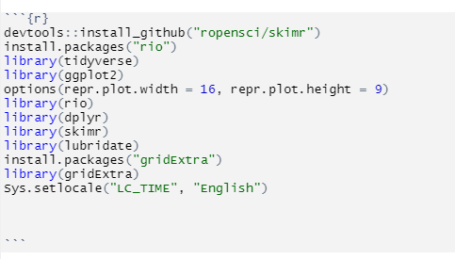
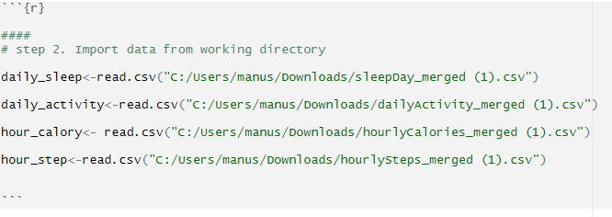
METHODOLOGY
DATA COLLECTION
DATA CLEANING
NORMALITY
CORRELATION
STATISTICAL ANALYSIS
REGRESSION ANALYSIS
VISUALISATION

Slide 6
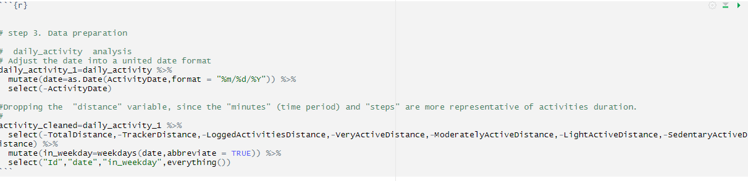
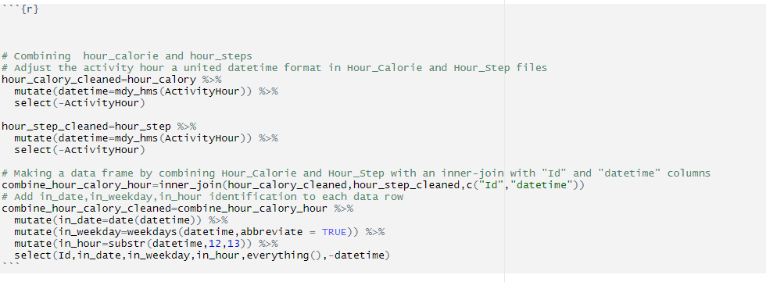
DATA CLEANING

Slide 7
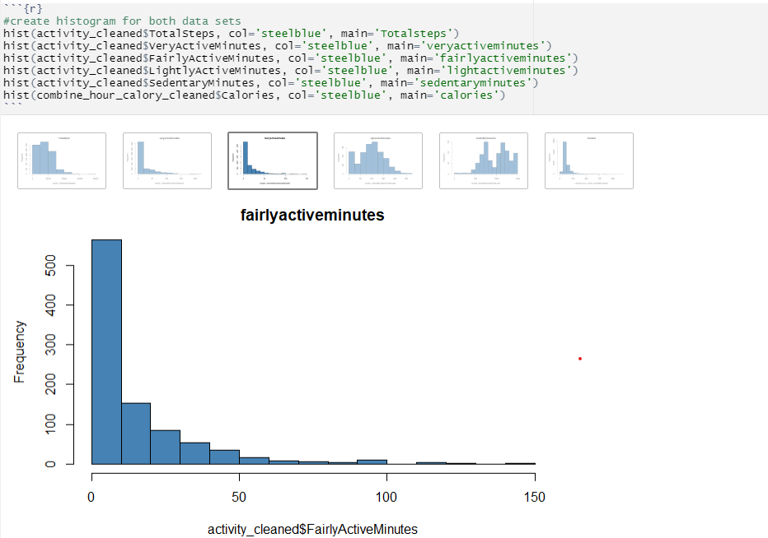
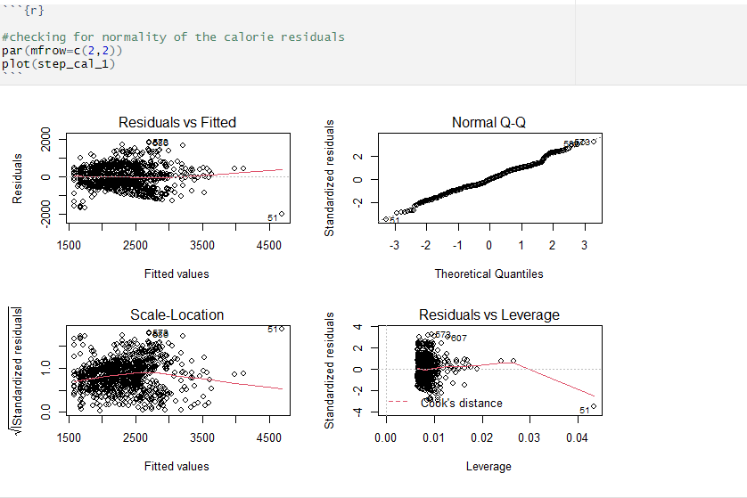
NORMALITY
No predictors in the data set are having normally distributed data. Almost all the predictors are having positively skewed data
The normality assumptions for the calorie residuals were checked using the quantile plots, there is close conformity to the normal distribution of residuals as shown by the Q-Q norm plots since residuals are consistent with the predicted quantiles line.

Slide 8

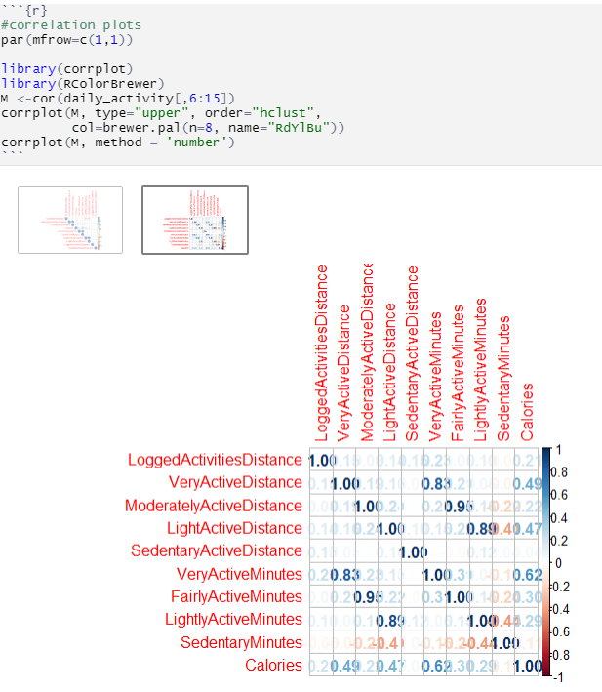
CORRELATION
Here from the correlation matrix, we can observe that FairlyActiveMinutes and ModeratelyActiveDistance have the highest positive correlation and LightlyActiveMinutes and LightlyActiveDistance have a highly positive correlation followed by VeryActiveMinutes and VeryActiveDistance with a correlation value of 0.83.
SedentaryMinutes and LightlyActiveMinutes are moderately negatively correlated.

Slide 9
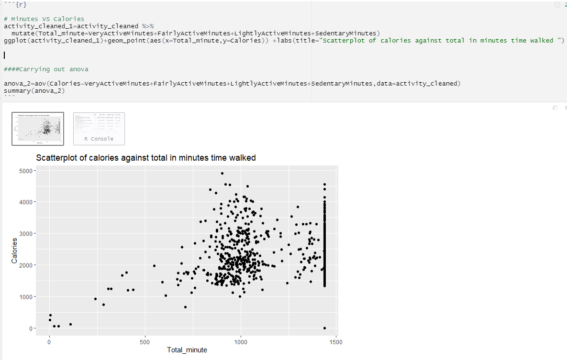
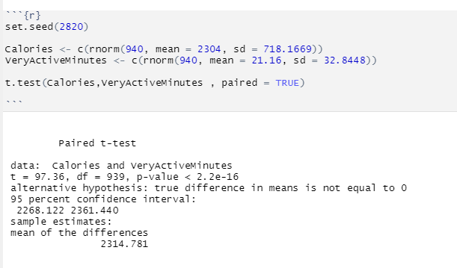
ANALYSIS:
There is no discernible relationship between minutes and calories in the graph. It is because there are many types of activities. As a result, we can't only utilize total minutes for correlation. As a result of the data, the activity is divided into four categories: "Very Active," "Fairly Active," "Lightly Active," and "Sedentary." Each plot is created independently here
All the different levels of activity have a significant influence on calory consumption among fitness devices users. 95% confidence interval indicates the true difference between means. P-value is less than 0.05 which indicates there is an association.

Slide 10
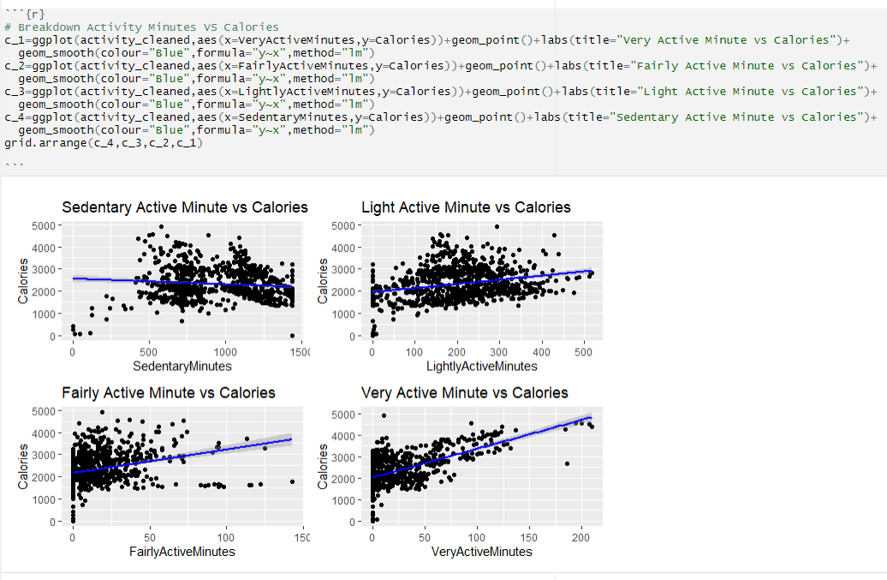
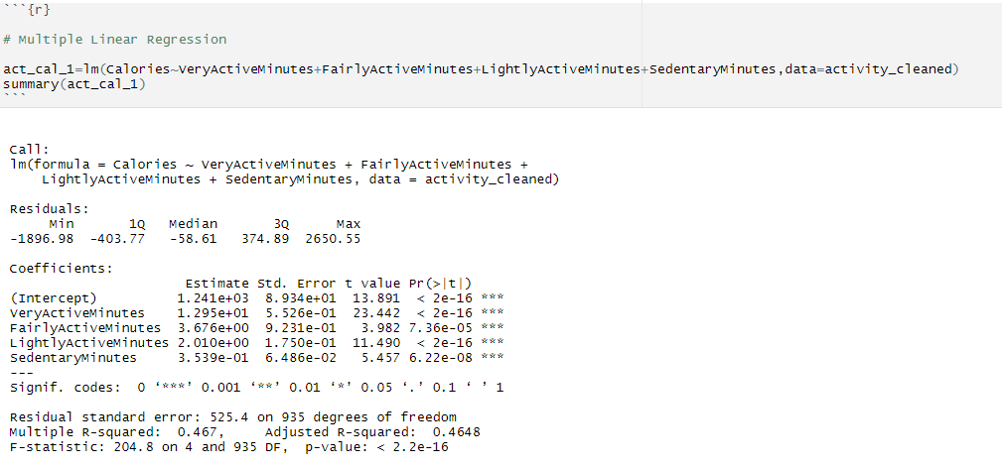
Isolating total time in terms of activity intensity results in a graph with distinct slopes for regression lines. This is completely sensible, given different degrees of activity varying amounts of calories. In theory, more active people should consume more energy than those who are more sedentary. As a result, a multivariable regression on the relationship between each type of activity and calories can be derived.

Slide 11
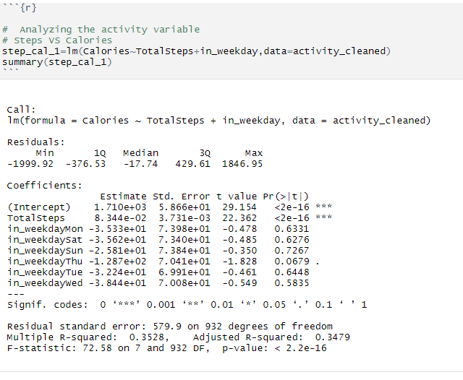
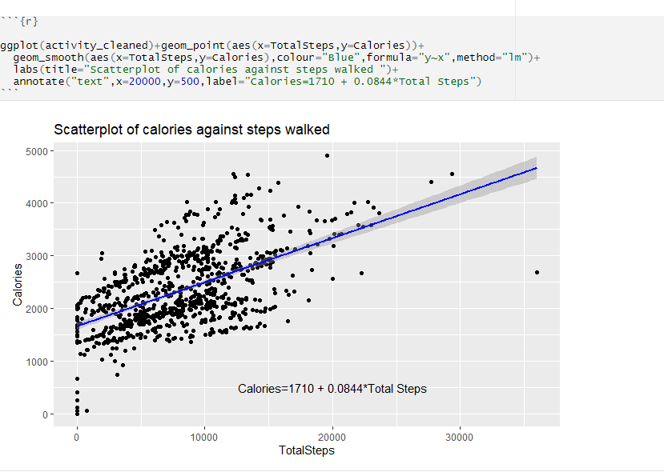
The association between the calories burnt, the day of the week, and the total steps walked was presented using a linear regression model. The calorie burn is anticipated to increase by a factor of 0.0834 as the number of steps performed when walking increases by one. The p-value is quite small for the linear regression line. As a result, the total number of steps taken is significantly associated with the number of calories ingested. A plot of this linear regression line on a graph would be obtained using the formula; Calories=1710+ 0.0834 * Total Steps.

Slide 12
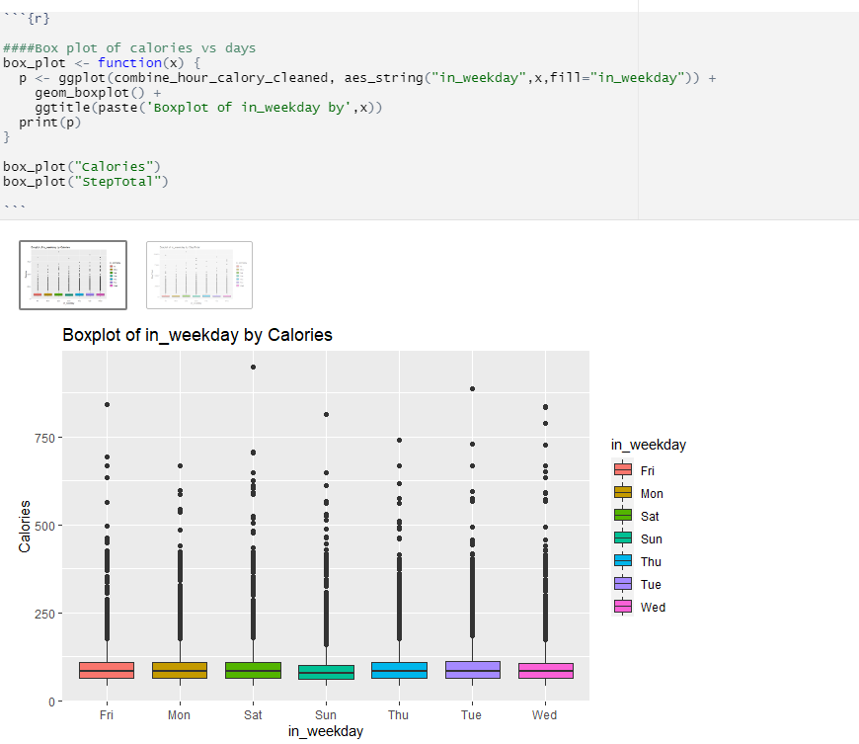
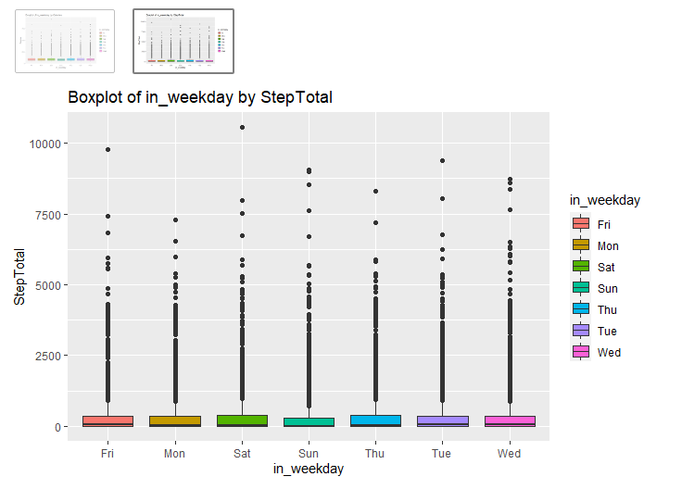
Box plot of in weekdays by calories
DATA VISUALISATION
The distribution of calories by weekdays shows no significant variation in median hourly calories with respect to the weekday. As a result, calorie variation is unaffected by the weekday.
Box plot of total steps and on weekdays
The number of steps walked on Sunday appears to be lower in the median and upper quartiles than on the rest of the days.

Slide 13
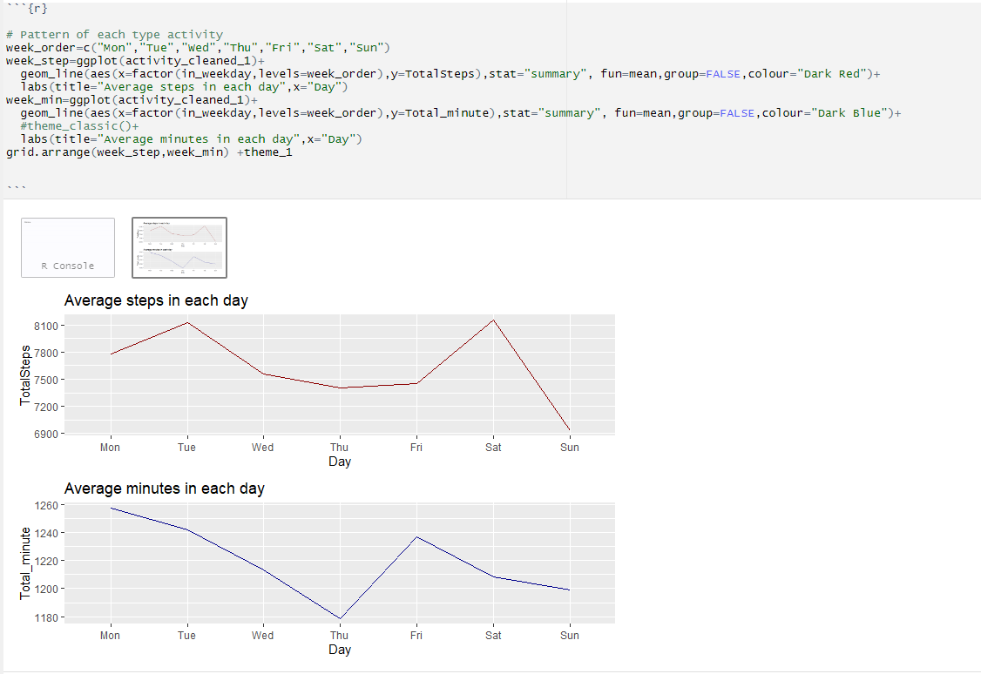
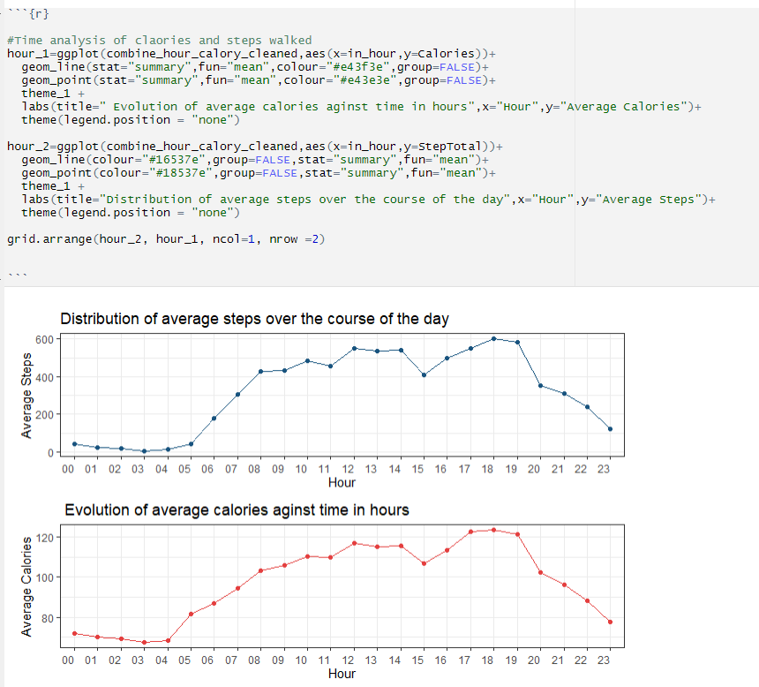
With the exception of a few daily changes, the line charts show average steps and activity minutes over a week show no apparent trend or pattern. Sunday had the lowest average steps and the second-lowest average activity minutes of the entire week.

Slide 14
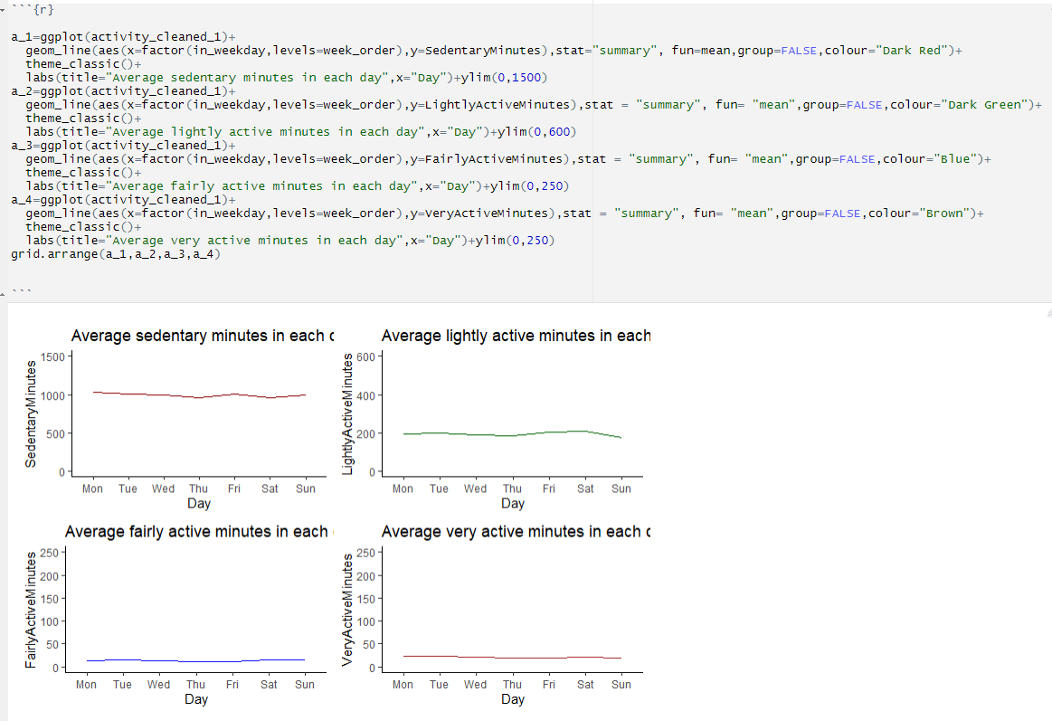
For activities in weekdays
When we break down activity further by activeness, we can observe that there is still no clear trend or pattern. In reality, throughout the course of a week, the average minute of Very Active, Fairly Active, and Lightly Active is fairly consistent. It indicates that people's workout or living habits will not change from day to day.

Slide 15

CONCLUSION:
There was a positive association between calories burnt and the number of steps walked. The high-intensity activity was associated with the highest extent of calory burnt.
Hence, we are rejecting the Null hypothesis.

Slide 16
REFERENCES
Bhargava, Y., & Nabi, J. (2020). The opportunities, challenges and obligations of Fitness Data Analytics. Procedia Computer Science, 167, 1354-1362.
Fereidooni, H., Frassetto, T., Miettinen, M., Sadeghi, A. R., & Conti, M. (2017, July). Fitness trackers: fit for health but unfit for security and privacy. In 2017 IEEE/ACM International Conference on Connected Health: Applications, Systems and Engineering Technologies (CHASE) (pp. 19-24). IEEE.
Guo, L., Sharma, R., Yin, L., Lu, R., & Rong, K. (2017). Automated competitor analysis using big data analytics: Evidence from the fitness mobile app business. Business Process Management Journal.
Data source: Link- https://www.kaggle.com/datasets/stanley888cy/google-project-02

Slide 17

THANK YOU

